Slide 1
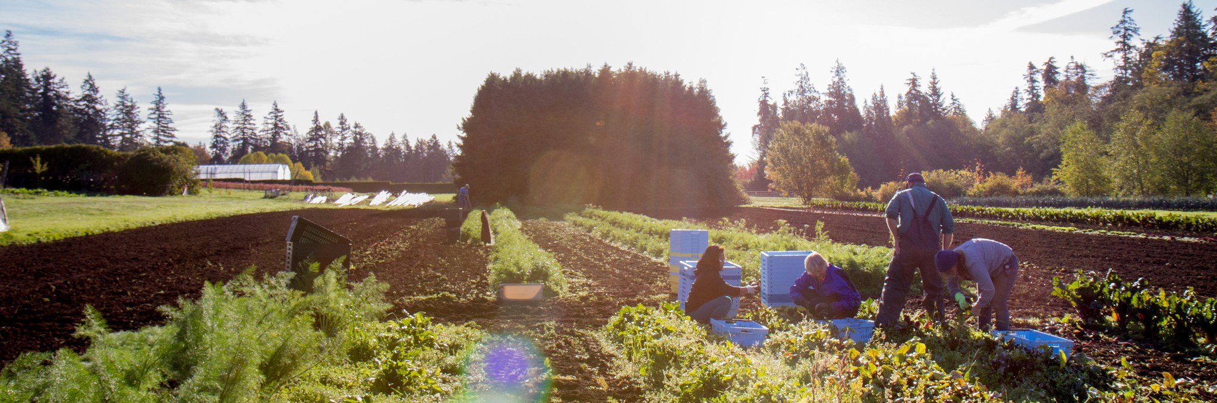
Empowering Agriculture: Enhanced GHG Emissions Modeling
Notes:
Proposal title: “Proposal: Leveraging data science for agricultural carbon and biodiversity outcomes”
Alternatives: Empowering Agriculture: GHG Emissions Modeling // Sustainable Farming: Optimizing GHG Emissions Analysis// Leveraging Data Science for Enhanced GHG Emissions Modeling in Agriculture

Slide 2

Team Introduction
Leveraging data science for a greener future
Team member
He Ma
Hancheng Qin
Yi Han
Mentor
Simon Goring
Partner
LiteFarm/UBC
Dr. Khanh Dao Duc
Notes:
LiteFarm team provide a free and open source farm management tool built for current and aspiring sustainable farmers.

Slide 3




Climate Change and GHG Emissions
Agriculture as a significant player
Notes:
Agriculture emits all three greenhouse gases: carbon dioxide (CO2), methane (CH4), and nitrous oxide (N20). Nitrous oxide (N2O), occurs primarily through agricultural activities like fertilizer application, livestock waste decomposition, and soil cultivation. Fertilizers contribute by providing excess nitrogen, which can be converted by soil microbes into nitrous oxide—a potent greenhouse gas. Livestock waste decomposition also generates nitrous oxide in anaerobic conditions.Ultimately, the nitrogen re-enters the atmosphere as nitrogen gas (N2) and — in smaller part — as N2O, a potent greenhouse gas.

Slide 4




Climate Change and GHG Emissions
Agriculture as a significant player
Notes:
Agriculture emits all three greenhouse gases: carbon dioxide (CO2), methane (CH4), and nitrous oxide (N20). Nitrous oxide (N2O), occurs primarily through agricultural activities like fertilizer application, livestock waste decomposition, and soil cultivation. Fertilizers contribute by providing excess nitrogen, which can be converted by soil microbes into nitrous oxide—a potent greenhouse gas. Livestock waste decomposition also generates nitrous oxide in anaerobic conditions.Ultimately, the nitrogen re-enters the atmosphere as nitrogen gas (N2) and — in smaller part — as N2O, a potent greenhouse gas.

Slide 5




Sustainable Farming with LiteFarm
Calculating GHG Emissions: Our Critical Contribution
GHG Emissions
Notes:
LiteFarm is an innovative farm management tool, which is designed by the LiteFarm team to empower farmers to make informed decisions for their farms, communities, and the planet. (e.g. interactive irrigation prescription)
Within the broader framework of LiteFarm, our collaboration with LiteFarm focuses on a specific yet critical aspect: calculating GHG emissions of the farms

Slide 6
Sustainable Farming with LiteFarm
Main objective: Empowering farmers, researchers and policy-makers
GHG Emissions
Notes:
LiteFarm is an innovative farm management tool, which is designed by the LiteFarm team to empower farmers to make informed decisions for their farms, communities, and the planet. (e.g. interactive irrigation prescription)
Within the broader framework of LiteFarm, our collaboration with LiteFarm focuses on a specific yet critical aspect: calculating GHG emissions of the farms

Slide 7
Objectives
GHG Emissions Modeling
Confront existing models with high quality global scale data
Enhance GHG Emission Modeling

Slide 8



Objectives
GHG Emissions Modeling
Confront existing models with high quality global scale data
Soil
Climate
Crops
Enhance GHG Emission Modeling

Slide 9



Objectives
GHG Emissions Modeling
Confront existing models with high quality global scale data
Enhance GHG Emission Modeling
Investigating influencing parameters
Improving accuracy and robustness

Slide 10

LiteFarm Data

Slide 11
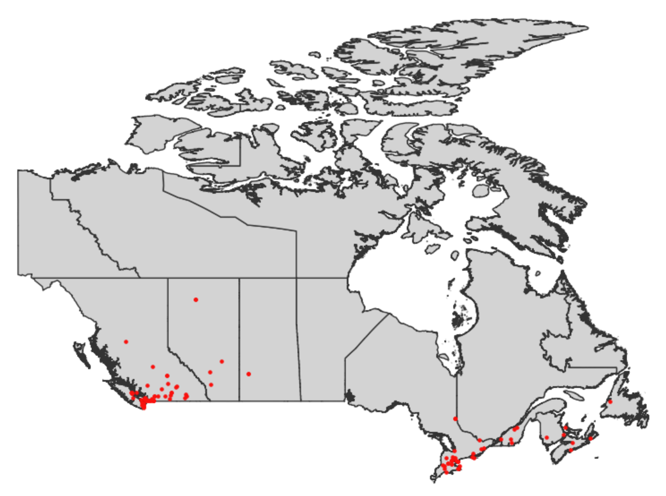
Farm Data
124 farms across Canada
- Farm id
- Location: lat/lon
- Area
- Crop types
- …

Slide 12



LiteFarm Database
Soil Data
Soil texture
Great group
…
Climate Data
Precipitation
Evaporation
...
GHG Estimation
Crop Data
Moisture content of product
Nitrogen contents
Lifecycle
...

Slide 13
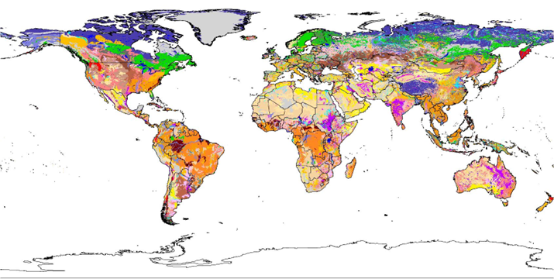



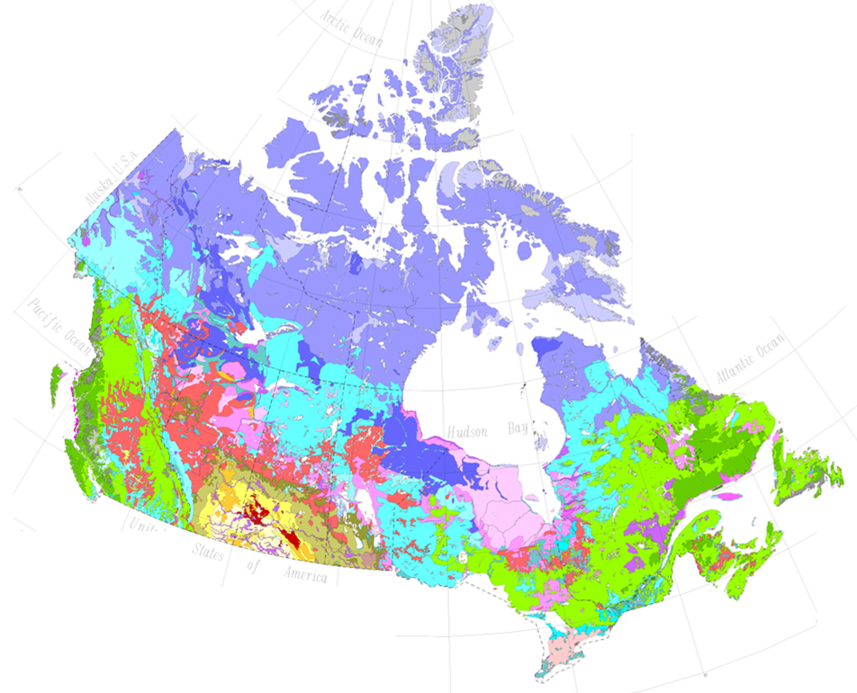
Sources of External Data
Soil data: FAO Harmonized World Soil Database
Climate data: NASA POWER Project database
- open source
- can be downloaded
Soil data: The Soil Landscapes of Canada (SLC)
Crop data: Peer-reviewed articles and government reports

Slide 14
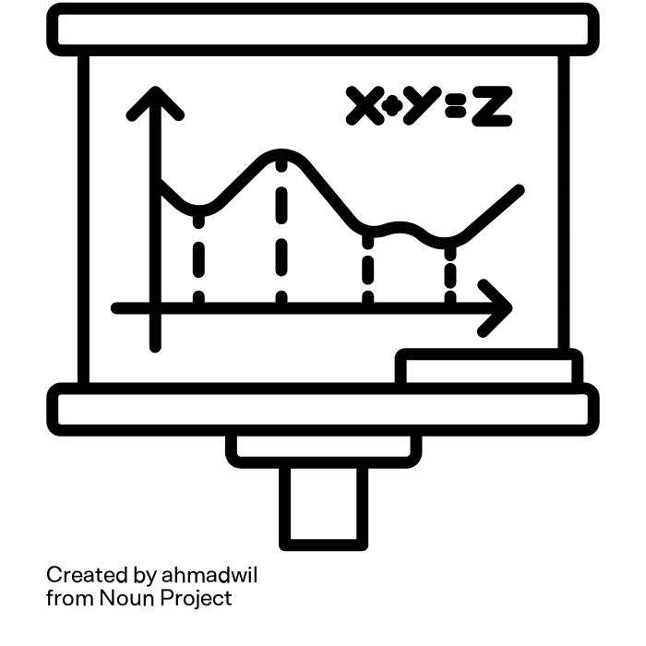
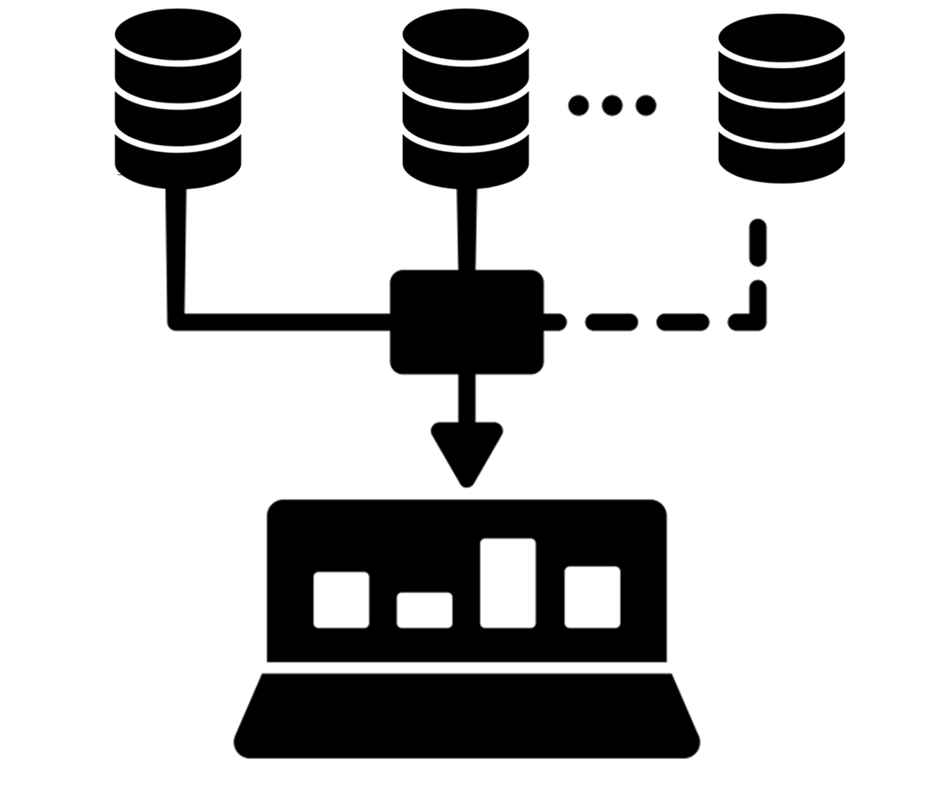



Enhanced GHG Emissions Modeling
rate = 10%
factor = 0.5
Identify and resolve discrepancies
Existing Models vs Python Implementation
Hard coding → Adaptable datasets
Improve accuracy / Influencing parameters

Slide 15
Method and techniques
GHG Model
Validating the current model
Developing and modularizing GHG calculation
Sensitivity Analysis
Multiple runs across farms / years, to identify key drivers of farm GHG emission
Dashboard
Design
Two new tabs: Farmer tab for farm-specific emission data; Scientist tab for result from sensitivity analysis

Slide 16
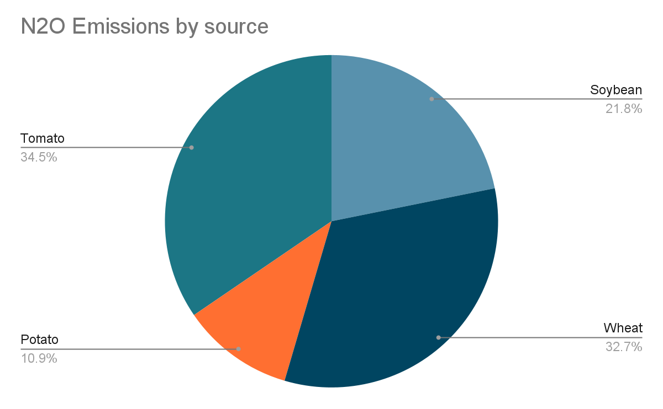
Success criteria
Success criteria
Achieve a more precise GHG estimation model
Allowing range input to provide more flexible calculation
Provide output with uncertainty
Establish Farmer and Scientist tabs on dashboard
Implement new features with the results of sensitivity analysis and visualize influential variables for the GHG calculation

Slide 17
Timeline
Weeks
1 | 2 | 3 | 4 | 5 | 6 | 7 | 8
Review data, formulate question
Establish and improve GHG emission model
Sensitivity analysis
Dashboard setup
Final deliverables refinement

Slide 18

Q&A
Team member
He Ma
Hancheng Qin
Yi Han
Mentor
Simon Goring
Partner
LiteFarm/UBC
Dr. Khanh Dao Duc

